Slide 1
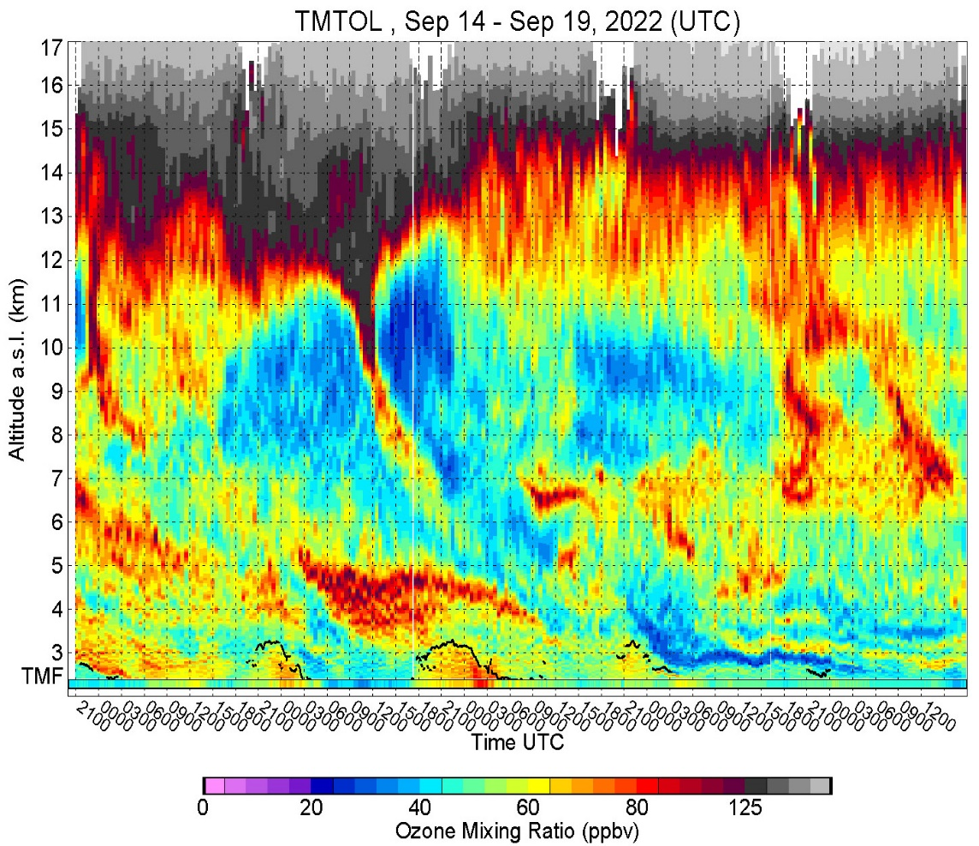
TOLNet Site Report JPL-Table Mountain Facility (TMF)
Thierry Leblanc, Fernando Chouza
NASA Jet Propulsion Laboratory California Institute of Technology

Slide 2
JPL-TMF TOLNet Site FY23 Accomplishments
T. Leblanc, F. Chouza, P. Wang and M. Brewer
Notable Publications (TOLNet-related)
Mettig, N., et al. (2022), Combined UV and IR ozone profile retrieval from TROPOMI and CrIS measurements, Atmos. Meas. Tech., 15(9), 2955-2978.
Knowland, K. E., et al. (2022), NASA GEOS Composition Forecast Modeling System GEOS-CF v1.0: Stratospheric Composition, Journal of Advances in Modeling Earth Systems, 14(6), e2021MS002852.
Chang, K.-L., et al. (2022), Impact of the COVID-19 Economic Downturn on Tropospheric Ozone Trends: An Uncertainty Weighted Data Synthesis for Quantifying Regional Anomalies Above Western North America and Europe, AGU Advances, 3(2), e2021AV000542.
Steinbrecht, W., et al. (2021), COVID-19 Crisis Reduces Free Tropospheric Ozone Across the Northern Hemisphere, Geophysical Research Letters, 48(5), e2020GL091987.
Field or Other Activities and Data Archived
Data archived up to April 30, 2023
259 measurement days in 2022-2023
70% routine nighttime profiles (CLIM product)
30% routine nighttime profiles (HIRES product)
TOAR-2, WMO O3 Assessment, and other NDACC Activities complement TOLNet
GLASS v1.2 now ready for 8 TOLNet instruments (TMTOL, SMOL1, SMOL2, TOPAZ, UAH, LMOL, TROPOZ, CCNY)
Files | Size [MB]
100s | 100s
Hardware and Personnel Updates
February/March 2023: “Snowmageddon” disrupted ops / hardware
Long time technologist Mark Brewer left group for Optical Communications Project
Running TOLNet project on 0.7 FTE (NDACC project running on 2.0 FTE, total 3.0 FTE for all Lidar/balloon activities)
New SMOl-1 and SMOL-2 now built and validated, kudos to Fernando
New personnel will be needed to secure/expand SMOL activities
Outlook for Next FY
Continue TMTOL for CLIM and HIRES reference standard for the SMOL
Keep SMOL-1 in Pasadena for the summer, and think about next location (AZ, UT, CA, etc.)
Deploy SMOL-2 to SoCal for summer, and think about next location (AZ, UT, CA, etc.)

Slide 3
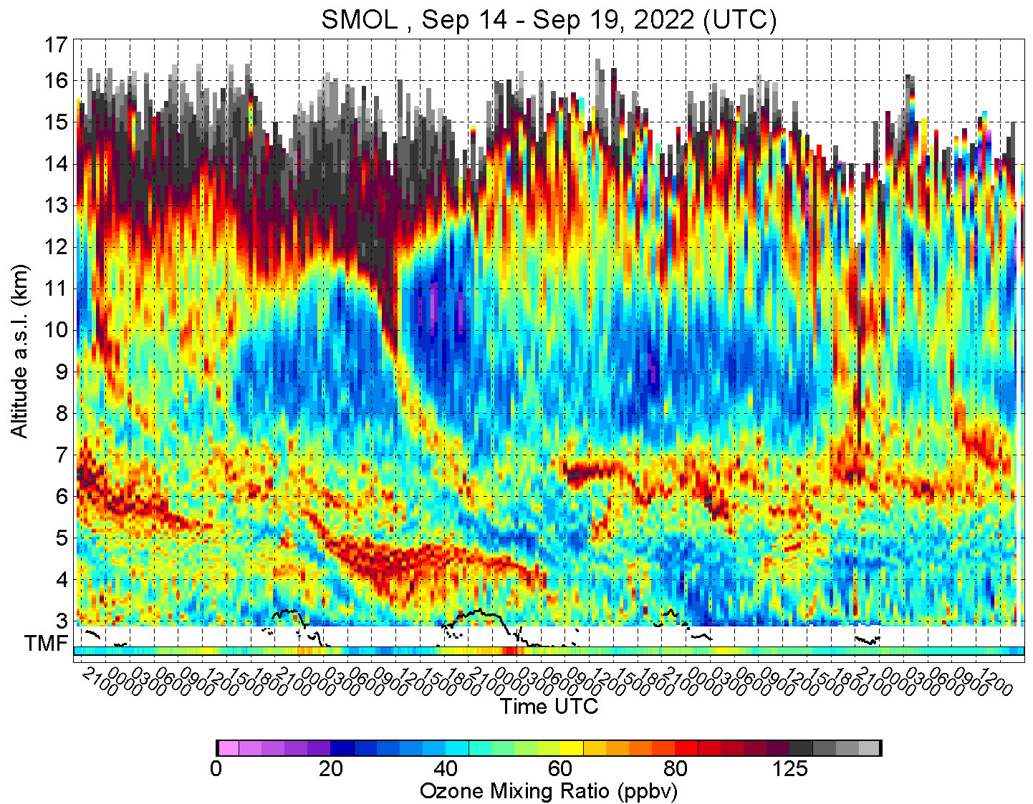

SMOL-1 (TMF)
TMTOL (TMF)
Sept. 2022

Slide 4
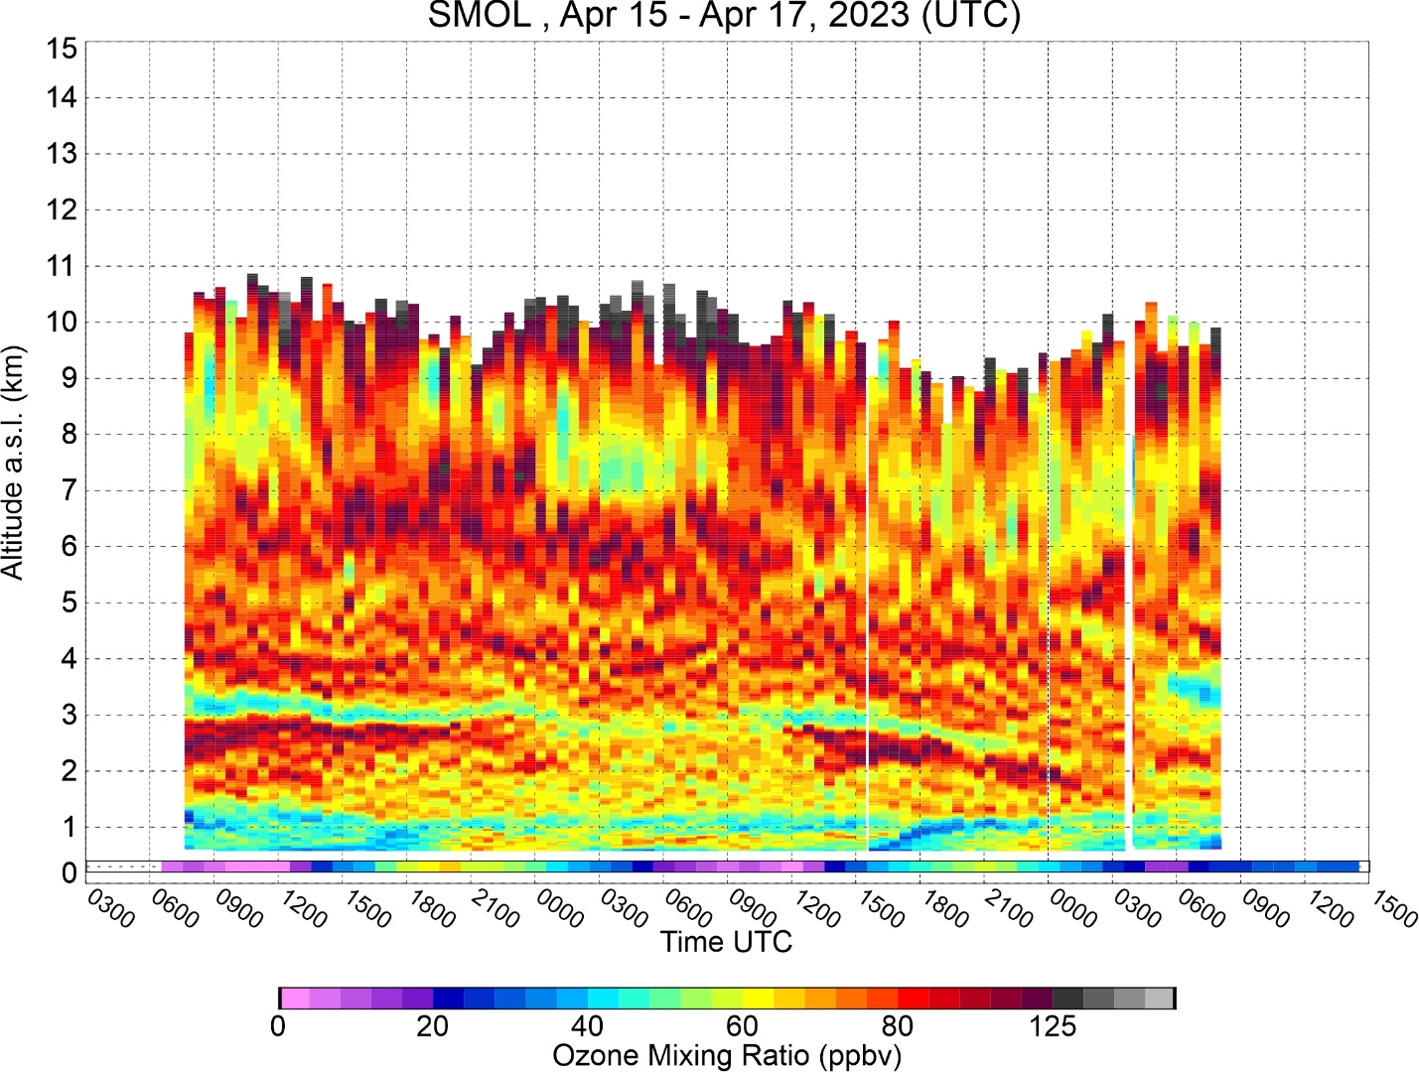
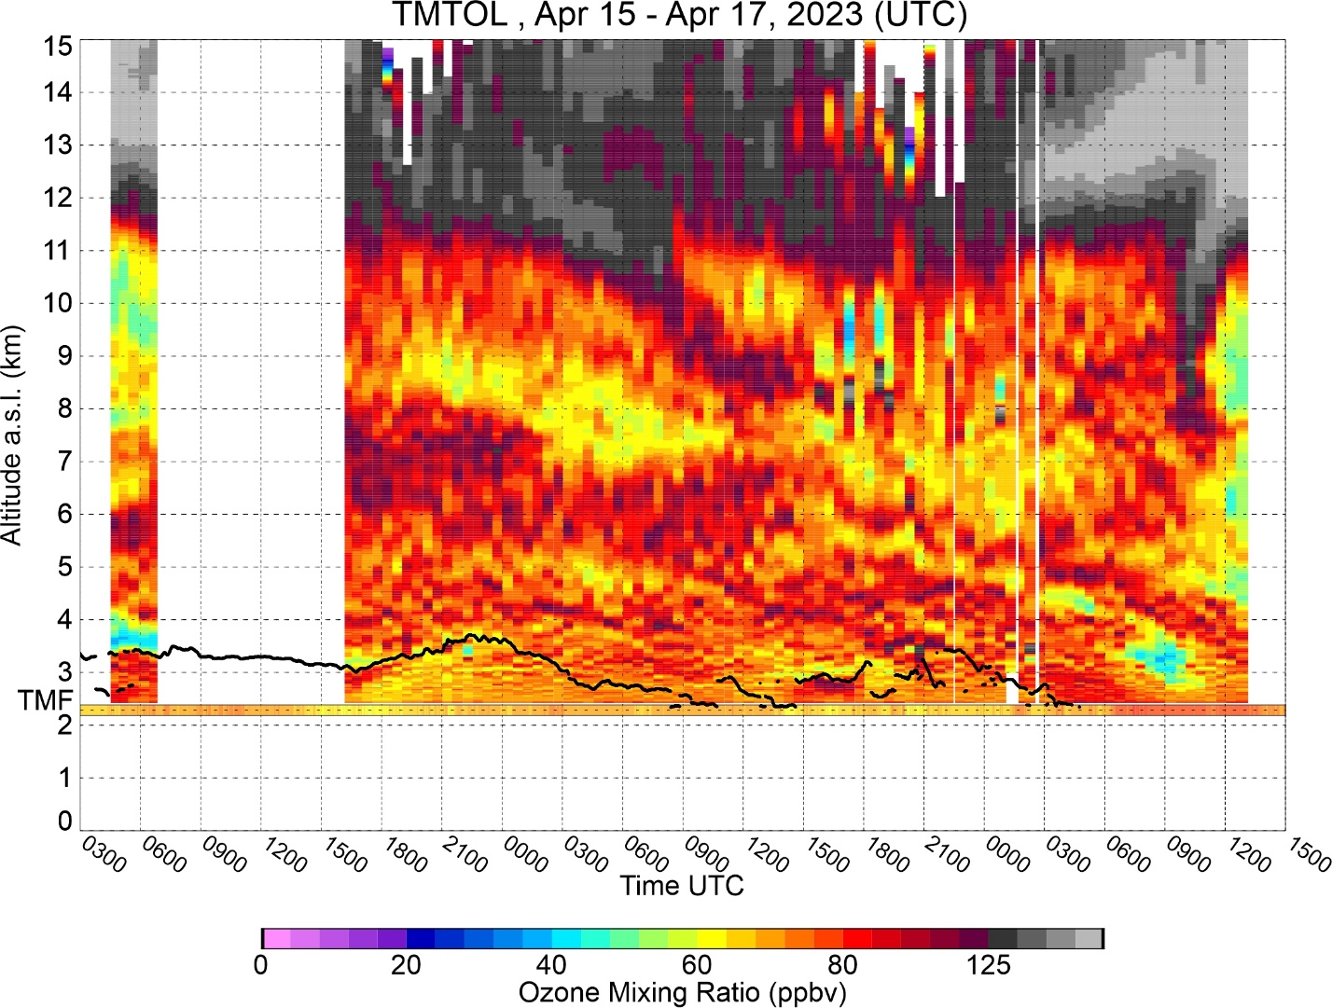
SMOL-1 (Pasadena)
TMTOL (TMF)
Apr. 2023

Slide 5
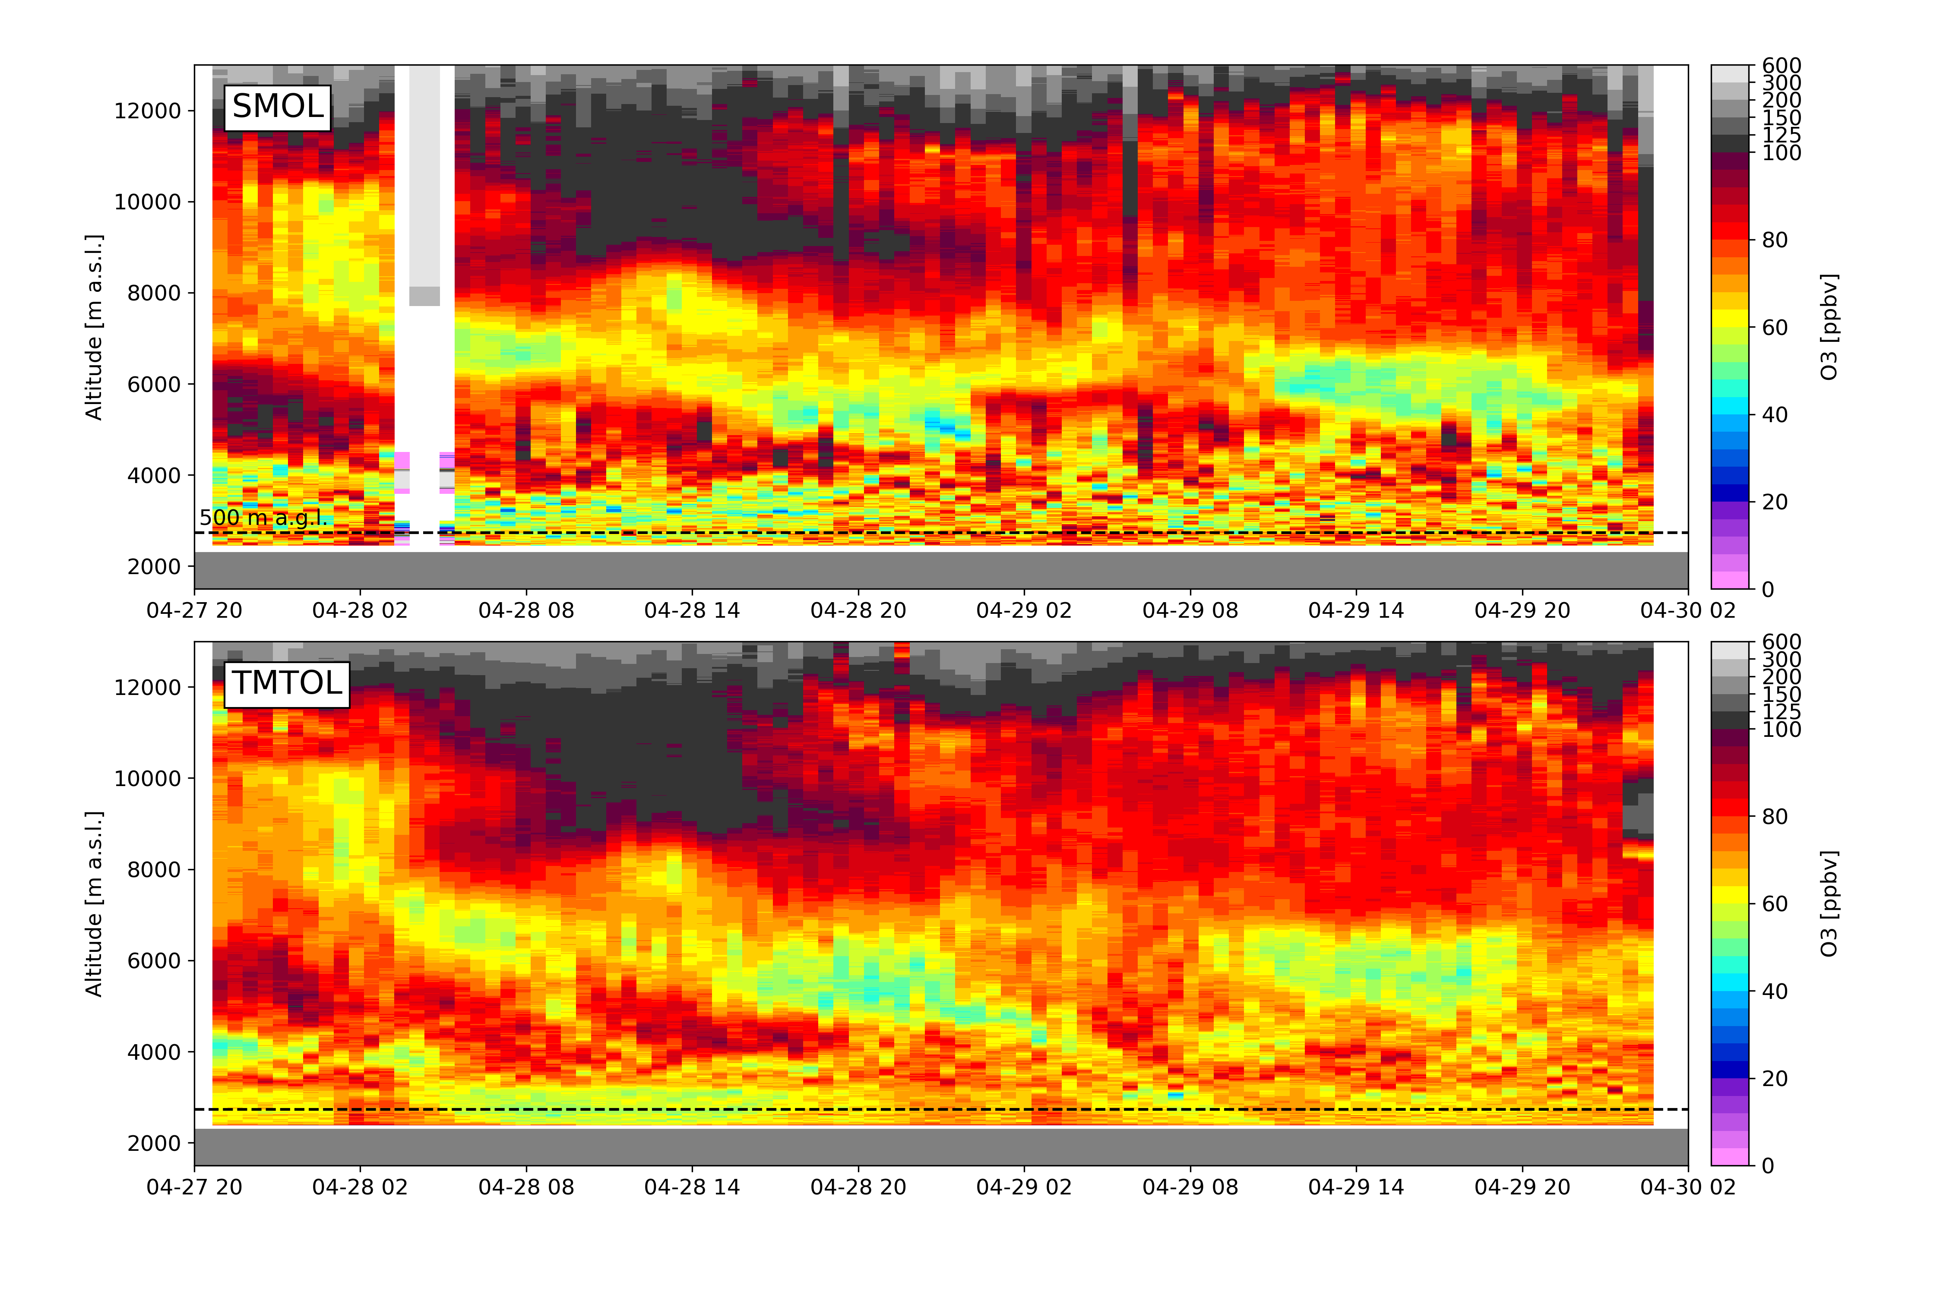
Apr. 2023
(quick-look)
SMOL-2 (TMF)
TMTOL (TMF)

Slide 6
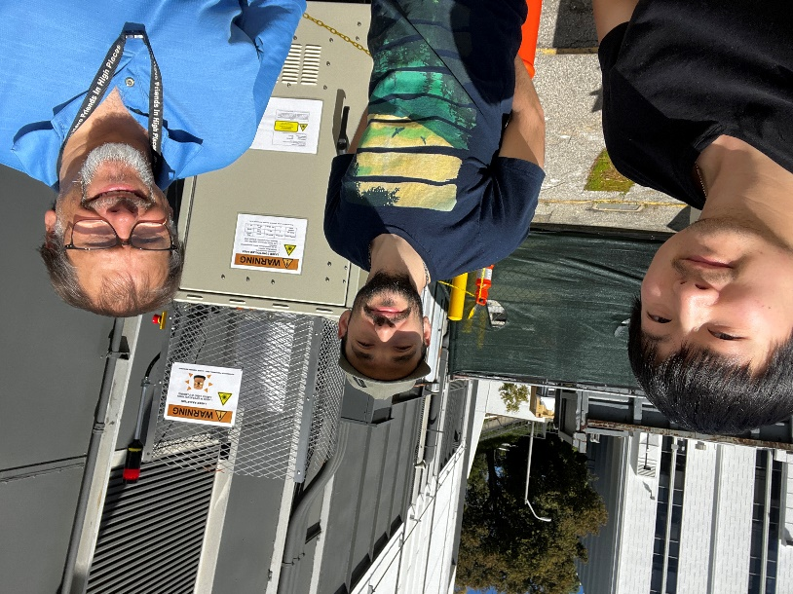
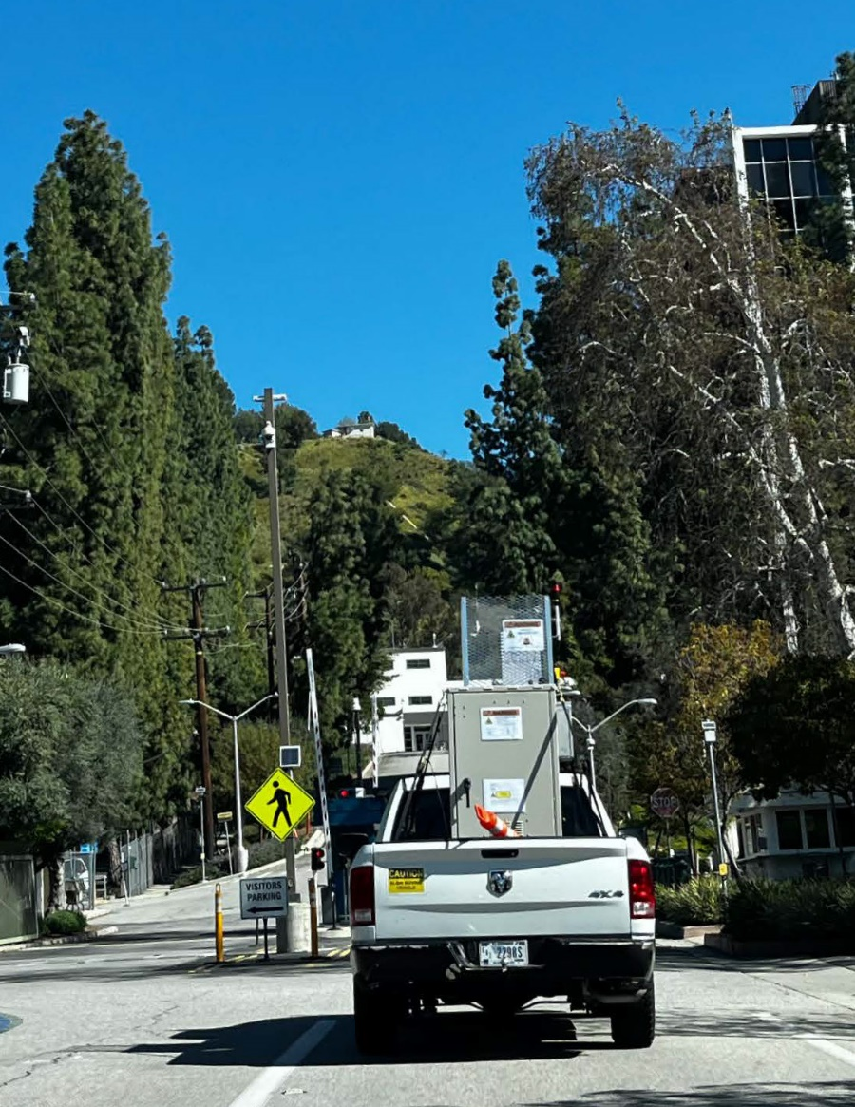
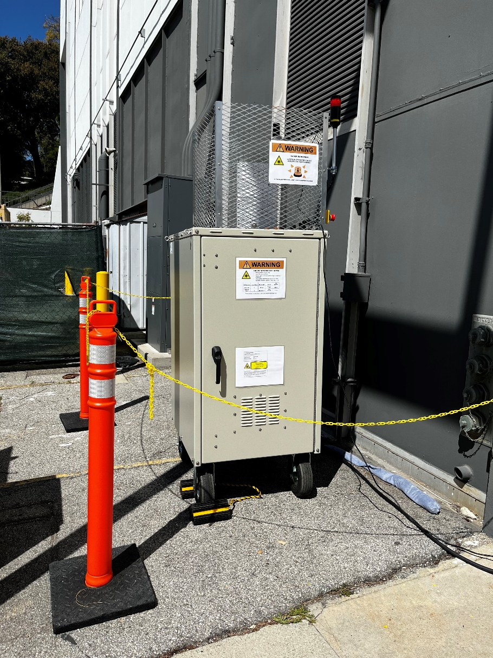
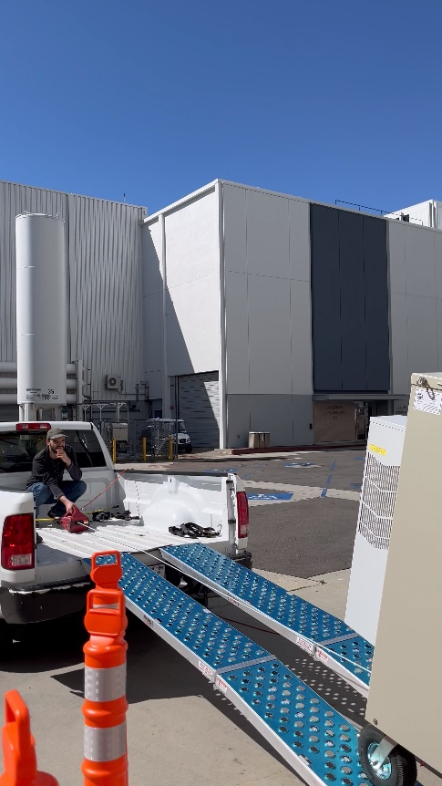
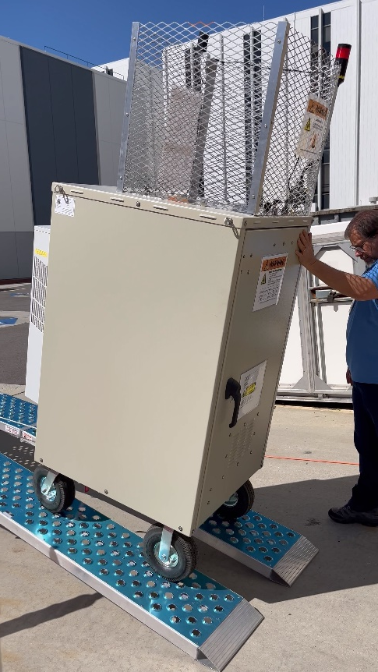
No, we didn’t buy it at Home Depot!
THANK YOU

Slide 7
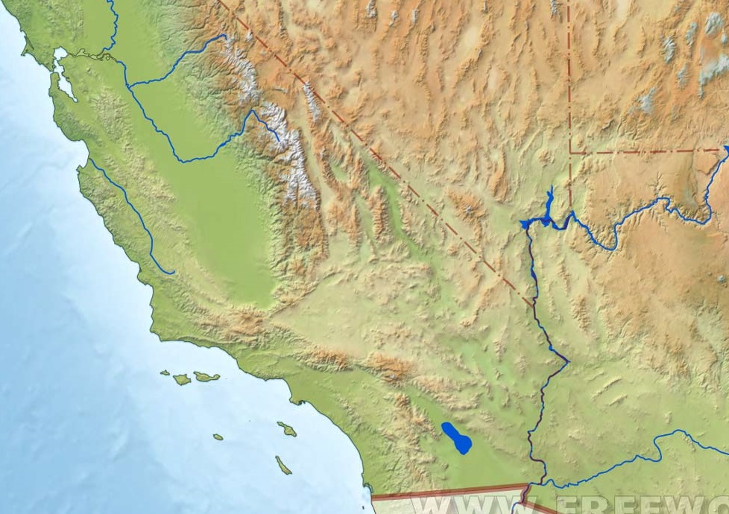
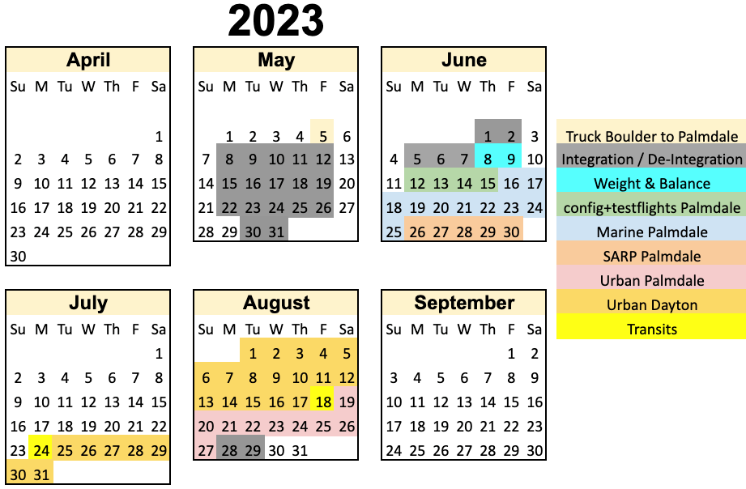
The JPL Lidars and AEROMMA / STAQS
Palmdale
NASA DC8 Base
JPL SMOL-1
TMF TMTOL
SMOL-2 option 2: SCMI
SMOL-2 option 3: WMSC
SMOL-2 option 1: SBO/Riverside

Slide 8
Hardware and deployment cost
Each new SMOL costs ~ $80k in parts to build (including ~ $40k for laser).
It takes ~ 3-4 weeks for one person to build a new SMOL once all parts are available. Maximum purchasing lead time is for laser and detectors (~ 3 months).
Operation cost is constrained by replacement of flashlamps and optics: ~ 2k for 60 days of 24/7 measurements.
Normal maintenance takes ~3 hours every 60 days.
Transportation cost depends on the availability of a pickup truck (typically low cost).
Cost for a space to deploy is TBD (currently looking for suitable locations).
Long-term durability is TBD (depends on laser and Raman cells).

Slide 9
SMOL – Present and Future
 | Hardware | Software | Science
< 0.5 years | - 2 SMOLs (one ‘finished’, one almost finished) - Testing reliability | - Cloud data backup - GLASS running at TMF for processing (manual) | - LA basin measurements
0.5-1 years | - More SMOLs - Extended aerosol capability - Improve durability (test diode pumped laser). | - GLASS running on cloud server for real-time processing (automated). | - STAQS/ TEMPO validation - LA pollution transport
> 1 years | - Explore further miniaturization | - Centralized real-time cloud processing | - Explore data assimilation for improved AQ forecasting - Further cooperation with AQ agencies (local studies)

